Slide 1


TEEGALA KRISHNA REDDY ENGINEERING COLLEGE
Department of Computer Science & Engineering
HEAD OF THE DEPARTMENT PROJECT CO-ORDINATOR
Dr. CH. V. PHANI KRISHNA DR. M .VINAYABABU
Professor Assistant professor

Slide 2

VIRTUAL MOUSE USING HAND GESTURES
AI
INTERNAL GUIDE:
Mrs. G.SWETHA
Asst .professor
BATCH-A15
B .Blessy Priya :23R91A0539

Slide 3
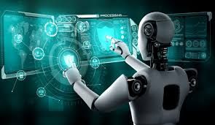
CONTENTS
ABSTRACT
INTRODUCTION
EXISTING SYSTEM
PROPOSED SYSTEM
SYSTEM REQUIREMENTS (HARDWARE & SOFTWARE)
SYSTEM ARCHITECTURE
OUTPUT SCREENS
CONCLUSION
REFERENCES

Slide 4
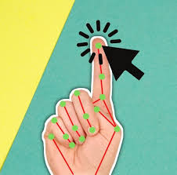
ABSTRACT
AI
This project introduces an Al-powered virtual mouse that enables touch-free interaction using hand gestures. It utilizes Media Pipe Hands for real-time tracking, OpenCV for video processing, and PyAutoGUI for mouse control, supporting cursor movement, clicks, and screenshots. NumPy ensures precise gesture recognition through angle and distance calculations. This contactless technology enhances hygiene, accessibility, and ease of use, making it ideal for public or medical environments. It also offers potential applications in AR/VR, gaming, and interactive simulations. Future enhancements will include advanced gesture controls for scrolling, zooming, and object selection, further improving user experience.

Slide 5
INTRODUCTION
AI
The "AI Virtual Mouse Using Hand Gestures" project allows users to control mouse functions through simple hand gestures, eliminating the need for physical contact. By using a webcam and MediaPipe for detecting 21 hand landmarks, the system accurately maps gestures to actions such as cursor movement, left and right clicks, double click, and scrolling. It integrates OpenCV for real-time image processing and PyAutoGUI for executing mouse events. Unlike earlier systems that required gloves or color markers, this implementation is markerless, efficient, and user-friendly. It is especially beneficial in touch-free environments like hospitals, public kiosks, and for people with mobility limitations. The project demonstrates how AI can create smarter, more accessible human-computer interactions.

Slide 6
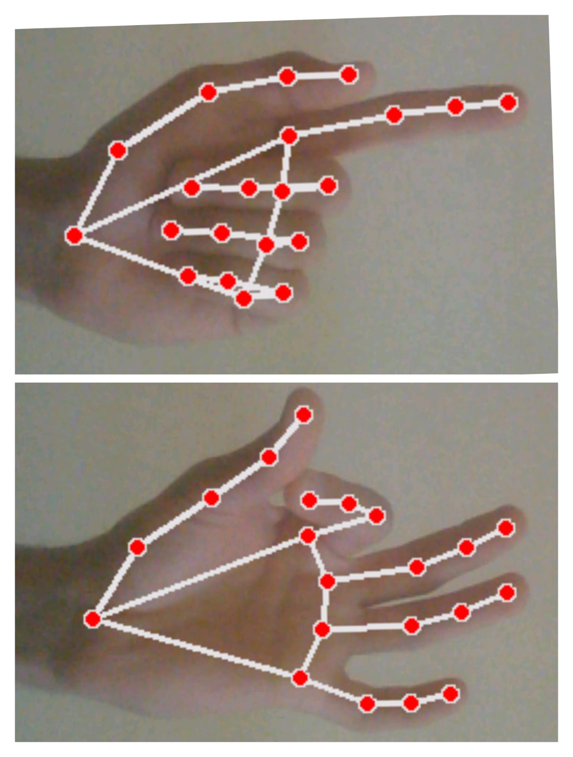
EXISTING SYSTEM
AI
Traditional systems rely on physical devices like a mouse or trackpad for actions like cursor movement and clicks. While effective, they require constant contact and aren’t ideal for touchless use. Alternatives like touchscreens or voice input lack precision and natural gesture support. Most existing systems don’t offer real-time, hardware-free gesture control to fully replace mouse functions.
LIMITATIONS
Accessory Dependency
Lighting Sensitivity
Low Accuracy
Limited Interaction Range
Lack of Gesture Diversity

Slide 7
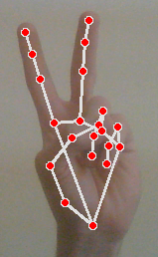
PROPOSED SYSTEM
AI
The proposed system uses a webcam and MediaPipe to recognize hand gestures for scrolling. Raising the index and middle fingers triggers scroll up, while lowering them triggers scroll down. It replaces traditional scrolling methods with accurate, touchless control. This ensures smooth and convenient navigation without physical input.
ADVANTAGES:
Enhanced Hygiene
Improved Accessibility
Flexibility and Convenience
Cost-Effective Implementation

Slide 8
SYSTEM REQUIREMENTS
AI
Hardware Requirements
Processor: Intel Core i3 or higher
RAM: Minimum 4 GB
Hard Disk: At least 500 GB
Webcam: Built-in or external webcam
Software Requirements
Operating System: Windows 7
Programming Language: Python
IDE: Python 3.8 or Visual Studio Code

Slide 9
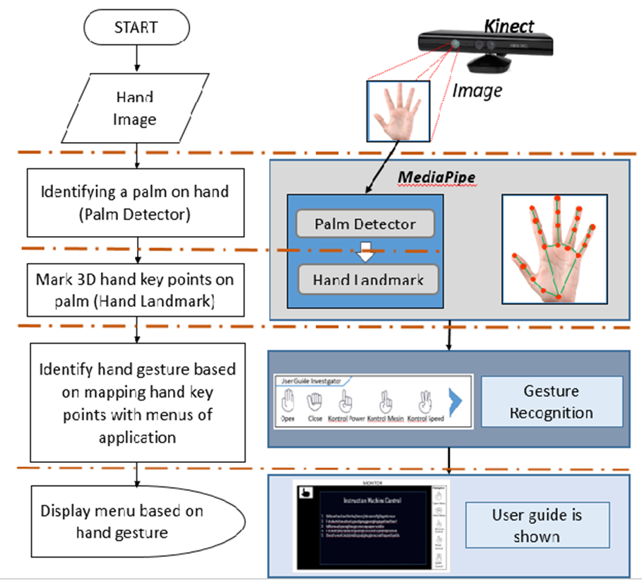
SYSTEM ARCHITECTURE
AI
Input Layer:
Processing Layer
Gesture Recognition
Action Mapping
Output Layer

Slide 10
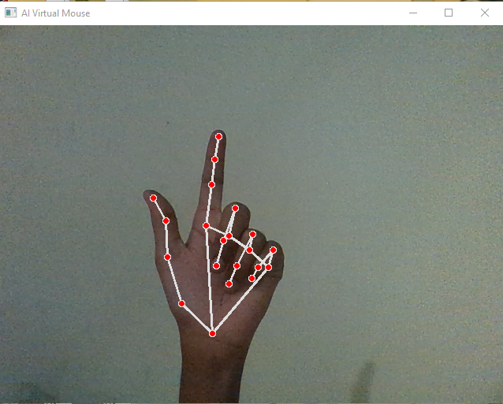
OUTPUT SCREENS
AI
Cursor Movement ➤ Gesture: Only index finger is raised and moved freely. ➤ Action: Controls the mouse cursor in real-time across the screen.
Fig 1

Slide 11
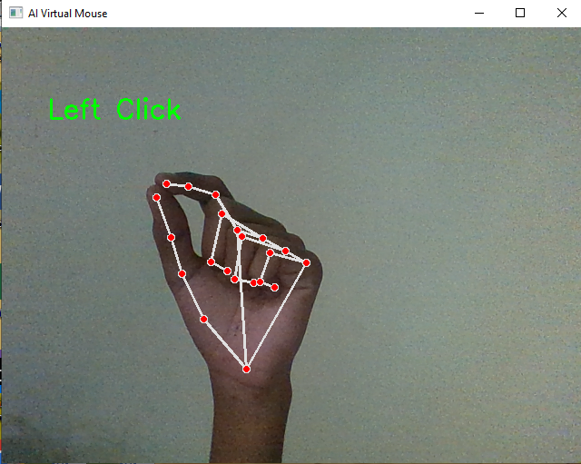
OUTPUT SCREENS
AI
Left Click ➤ Gesture: Thumb touches the tip of the index finger. ➤ Action: Performs a left-click operation on the screen.
Fig 2

Slide 12
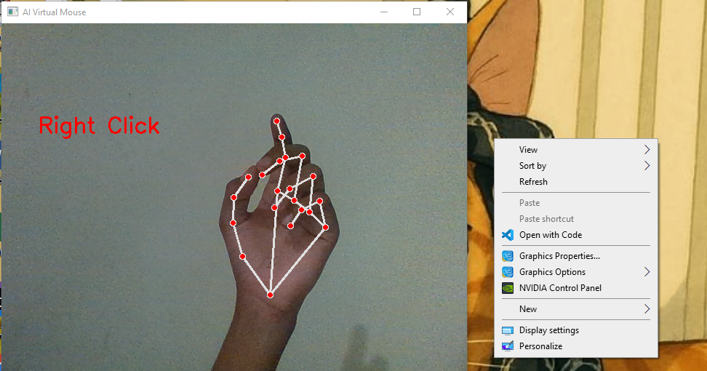
OUTPUT SCREENS
AI
Right Click ➤ Gesture: Thumb touches the tip of the middle finger. ➤ Action: Triggers a right-click operation.
Fig 3

Slide 13
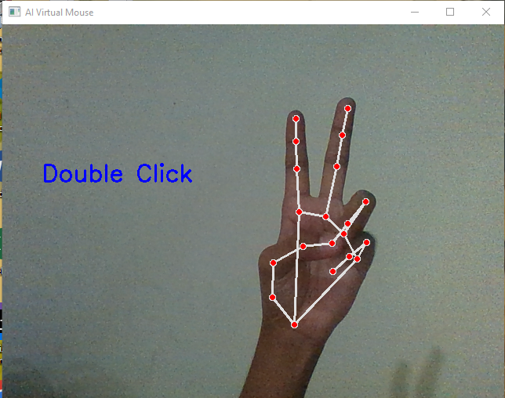
OUTPUT SCREENS
AI
Double Click ➤ Gesture: Thumb touches the tip of the ring finger. ➤ Action: Executes a double-click, similar to opening files or apps.
Fig 3

Slide 14
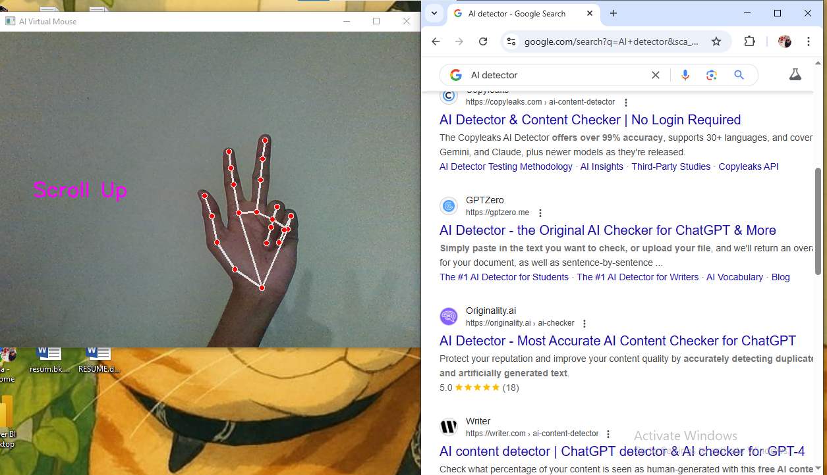
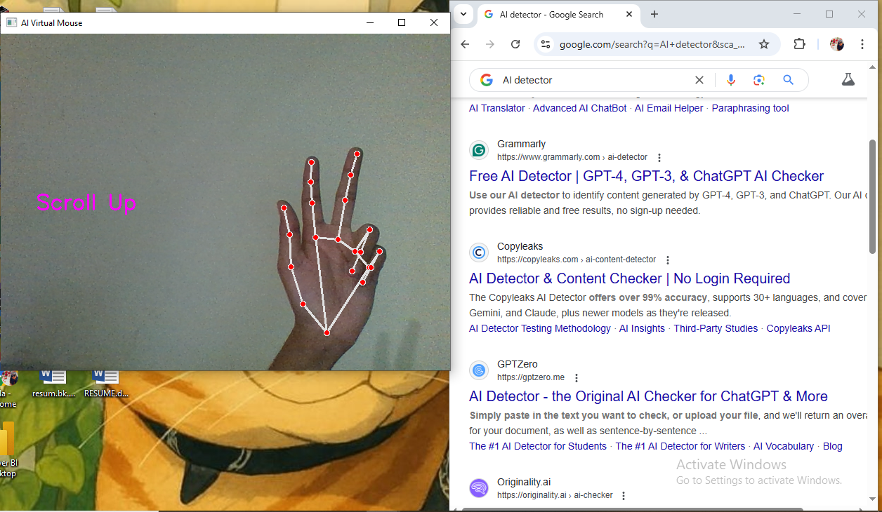
OUTPUT SCREENS
AI
Scroll Up ➤ Gesture: Both index and middle fingers raised upright. ➤ Action: Scrolls the screen upward, simulating mouse wheel up.
Fig 5

Slide 15
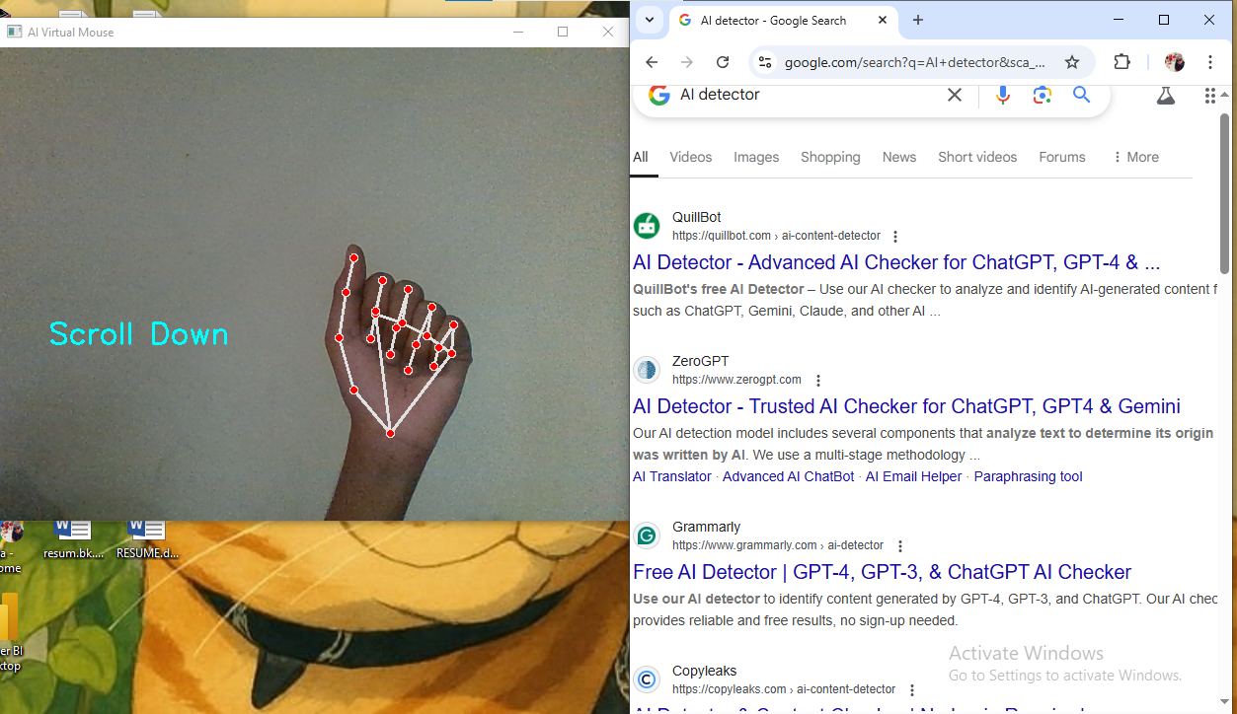
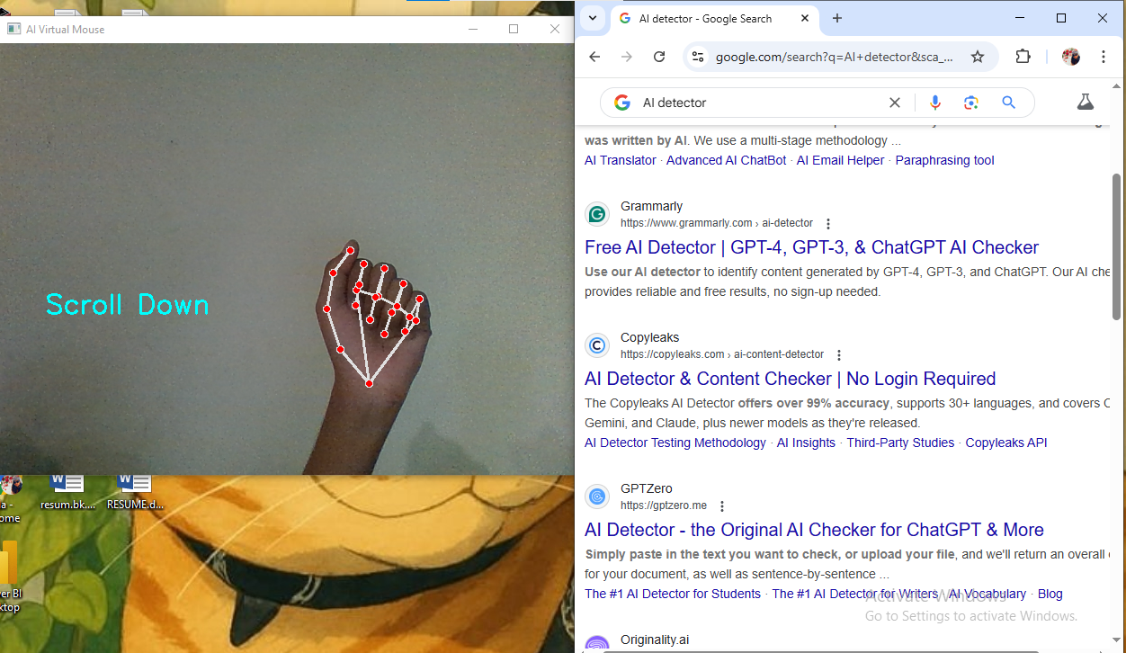
OUTPUT SCREENS
AI
Scroll Down ➤ Gesture: Index and middle fingers bent downward. ➤ Action: Scrolls the screen downward, like mouse wheel down.
Fig 6

Slide 16
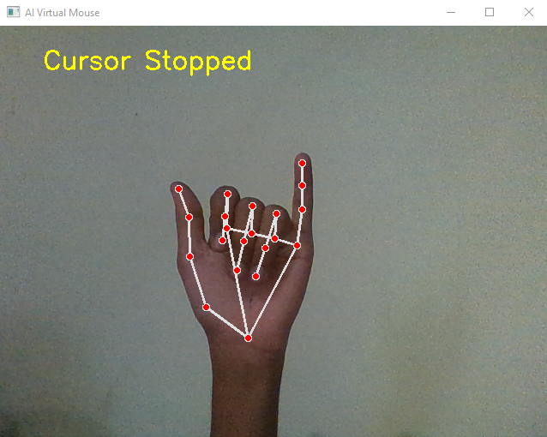
OUTPUT SCREENS
AI
Stop Cursor Movement ➤ Gesture: Pinky finger raised while other fingers remain low. ➤ Action: Halts cursor movement, pausing interaction temporarily.
Fig 7

Slide 17
CONCLUSION
AI
The AI Virtual Mouse allows users to control the computer using hand gestures, replacing traditional mouse functions. It uses a webcam to perform cursor movement, clicks, and scrolling without touch. This enhances hygiene, accessibility, and ease of use. The system shows how gesture recognition can improve human-computer interaction.

Slide 18
REFERENCE
AI
Amardip Ghodichor, Binitha Chirakattu, “Virtual Mouse using Hand Gesture and Color Detection”, International Journal of Computer Applications, Volume 128 – No.11, October 2015.
Rhitivij Parasher, Preksha Pareek, “Event Triggering Using Hand Gesture with OpenCV”, Volume 2, February 2016, pp. 15673-15676.
Abhilash S. S., Lisho Thomas, Naveen Wilson, Chaithanya C., “Virtual Mouse Using Hand Gesture”, IRJET, Volume 5, Issue 4, April 2018.
Zhang X., et al., “Hand Gesture Recognition Based on Deep Learning Using MediaPipe”, IEEE Access, 2020. DOI: 10.1109/ACCESS.2020.3042281
Lugaresi C., et al., “MediaPipe: A Framework for Building Perception Pipelines”, arXiv preprint, arXiv:1906.08172, 2019. https://arxiv.org/abs/1906.08172
Tugtekin U., Kaya Y., “AI-Based Virtual Mouse Implementation Using Hand Tracking for Human–Computer Interaction”, International Journal of Intelligent Systems and Applications in Engineering, 2021.

Slide 19

THANK YOU !!
AI

